Slide 1
A Modern Media Company
01
Milcheur Media LLC
01

Slide 2
02
A Modern Media Company
Making brands grow and consistently top of mind since 2000
Milcheur Media LLC
02

Slide 3

Why do we need a modern media company?
03
Because traditional forms of media need an upgrade.
A Modern Media Company

Slide 4
05
A Modern Media Company
Honesty and Transparency
Milcheur Media LLC Values
Reliability and Responsibility
Discipline and Perseverance
05

Slide 5
01
02
What Sets Us Apart?
Our Key Demographic
Constantly Innovating
06
03
04
Years of Experience
Affordable Quality
Service
A Modern Media Company
06

Slide 6
01
02
What Sets Us Apart?
Our Key Demographic
Constantly Innovating
06
03
04
Years of Experience
Affordable Quality
Service
A Modern Media Company
06

Slide 7

01
02
What Sets Us Apart?
Our Key Demographic
Constantly Innovating
06
03
04
Years of Experience
Affordable Quality
Service
A Modern Media Company
06

Slide 8



07
Target Market
Aspiring Bloggers
Startup Companies
Social Media Stars
07
A Modern Media Company

Slide 9
Social Media Marketing
Search Engine Optimization
Content
Strategy
Customer Relationship Management
Web and App Design and Development
Analytics and Reporting
A Modern Media Company
08
Digital Marketing Services
08

Slide 10




08
Creative Services
Branding and Identity
Business Collateral
Cards and Packaging
09
A Modern Media Company

Slide 11
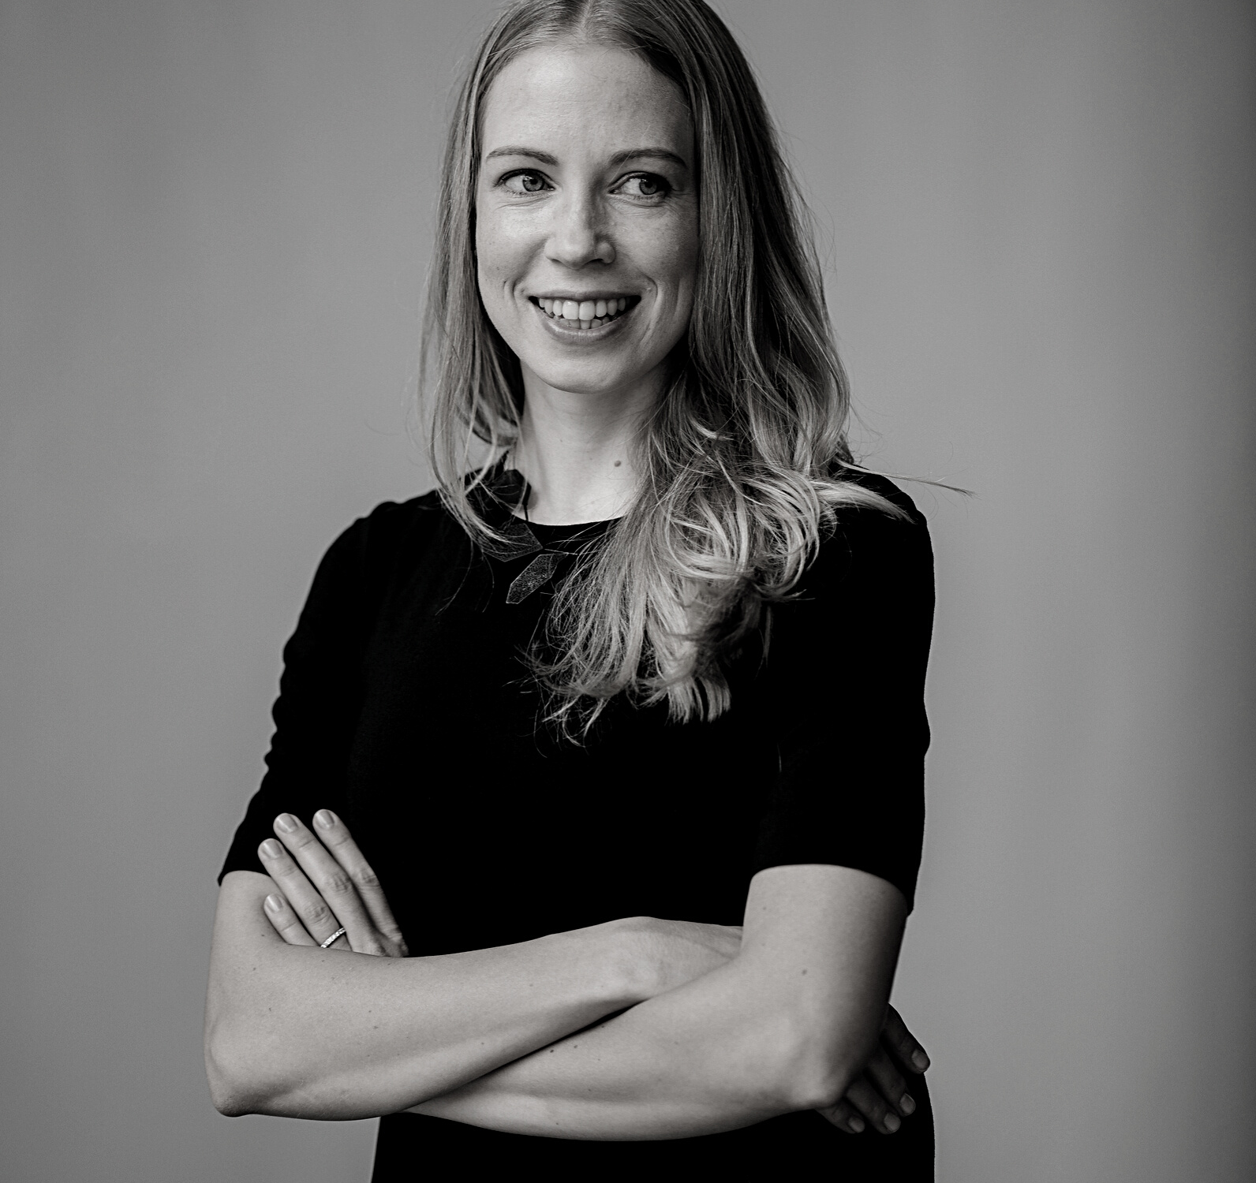
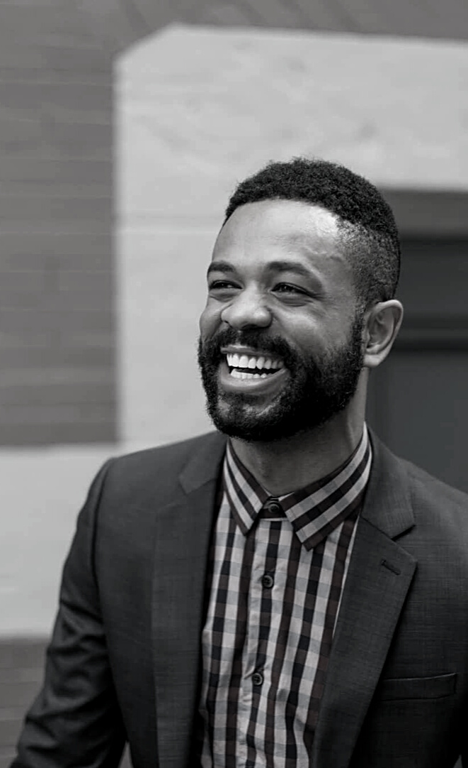

10
Our Team
Daniel Collins
Director
10
Whitney Blos
A Modern Media Company
Manager
George Hans
Creative Head

Slide 12
123 Anywhere St., Any City, State
A Modern Media Company
(123) 456 7890
(123) 456 7890
www.reallygreatsite.com
hello@reallygreatsite.com
Contact Us
02

